Slide 1
Techniques for Fault Detection and Visualization of Telemetry Dependence Relationships for Root Cause Fault Analysis in Complex Systems
Nathaniel Guy
(With support of Dr. Mehran Mesbahi and Dr. Jeffrey Heer)
Robotics, Aerospace, and Information Networks Lab
University of Washington - William E. Boeing Aeronautics and Astronautics
MSAA Thesis Presentation – March 16th, 2016

Slide 2
Overview
Motivation and Objectives
Model Definition
Fault Detection Background
Correlative Analysis and Visualization Background
Lunar Rover Ground Station Development
Intermediate Testing
2D Embedding Visualizations
Future Work and Conclusion
Acknowledgements
References

Slide 3
Overview
Motivation and Objectives
Model Definition
Fault Detection Background
Correlative Analysis and Visualization Background
Lunar Rover Ground Station Development
Intermediate Testing
2D Embedding Visualizations
Future Work and Conclusion
Acknowledgements
References

Slide 4
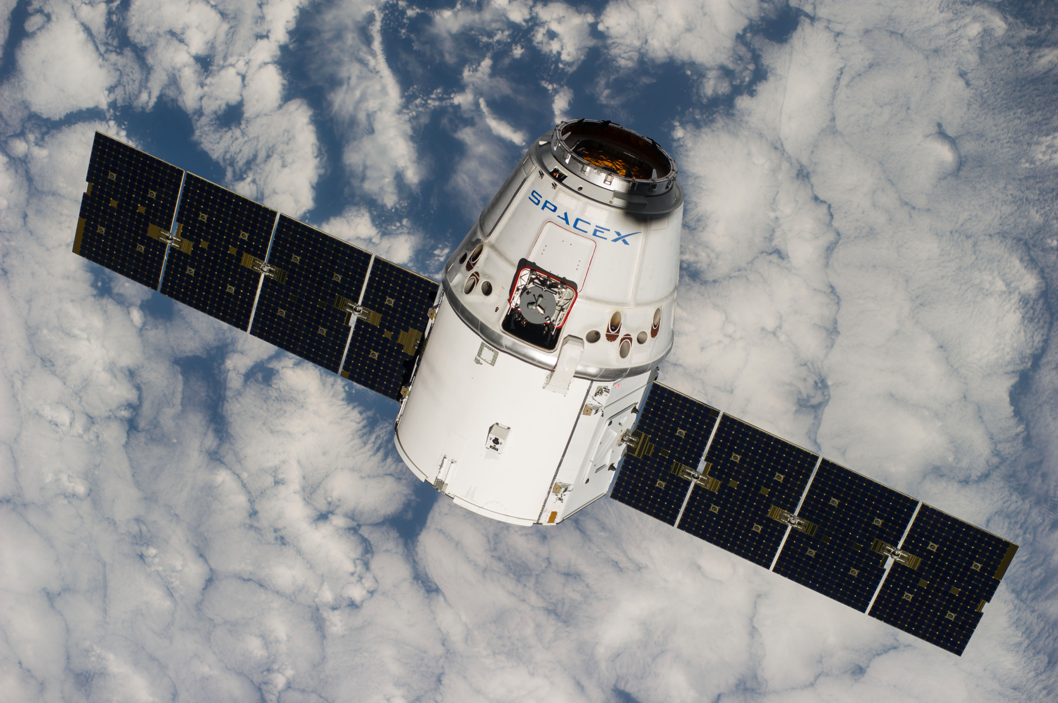
Remote-Operated Systems

Slide 5
Root Cause Analysis

Slide 6
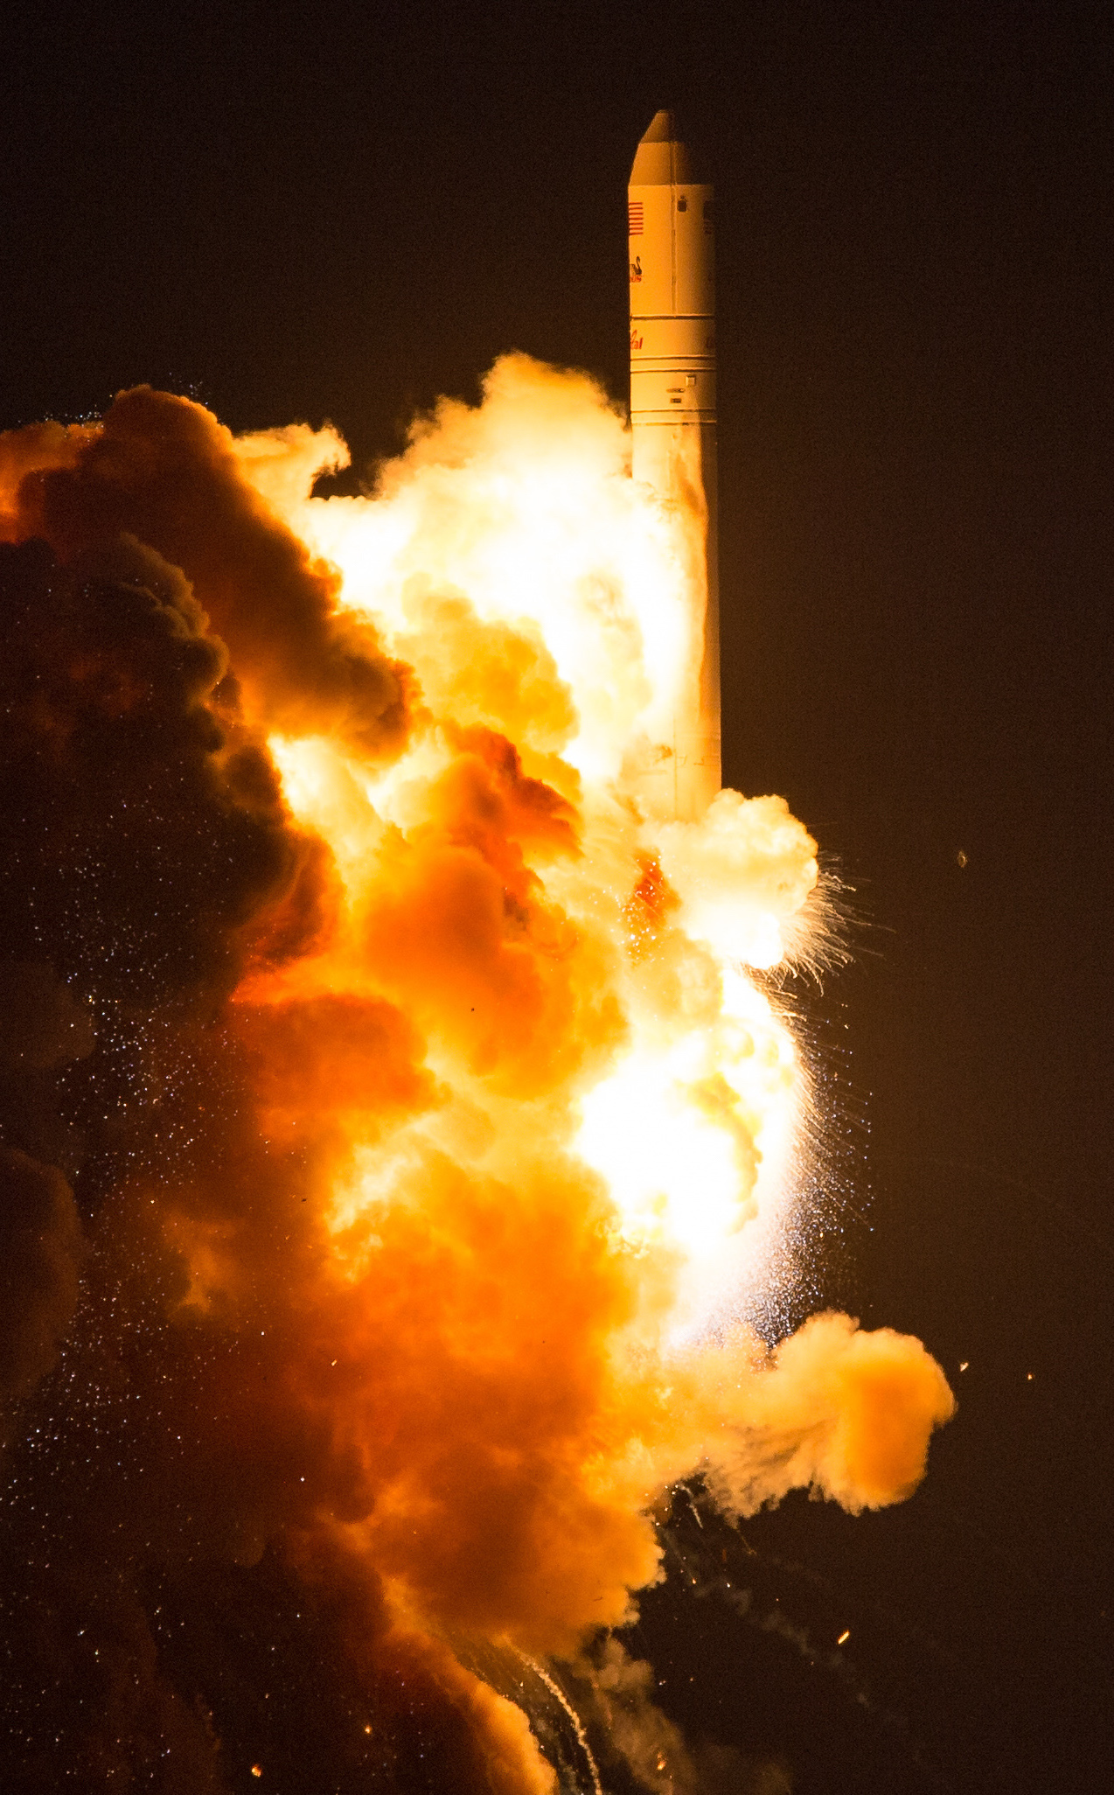
Antares CRS Orb-3

Slide 7
Objectives

Slide 8
Overview
Motivation and Objectives
Model Definition
Fault Detection Background
Correlative Analysis and Visualization Background
Lunar Rover Ground Station Development
Intermediate Testing
2D Embedding Visualizations
Future Work and Conclusion
Acknowledgements
References

Slide 9
Data Sources

Slide 10
State-Space Model

Slide 11
Overview
Motivation and Objectives
Model Definition
Fault Detection Background
Correlative Analysis and Visualization Background
Lunar Rover Ground Station Development
Intermediate Testing
2D Embedding Visualizations
Future Work and Conclusion
Acknowledgements
References

Slide 12
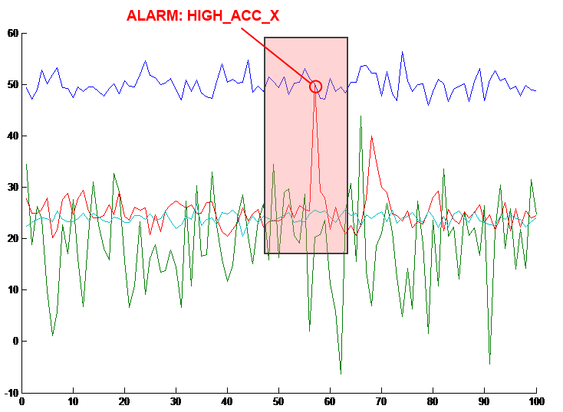
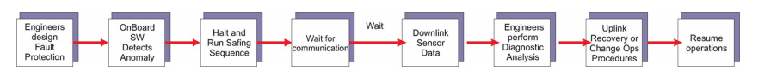
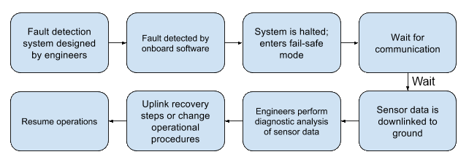
Fault Detection, Isolation, and Recovery

Slide 13
Residual Generation and Fault Detection

Slide 14
Overview
Motivation and Objectives
Model Definition
Fault Detection Background
Correlative Analysis and Visualization Background
Lunar Rover Ground Station Development
Intermediate Testing
2D Embedding Visualizations
Future Work and Conclusion
Acknowledgements
References

Slide 15

Correlative Analysis: Motivation

Slide 16
Covariance

Slide 17
Correlation Metrics

Slide 18
Static Corrgrams

Slide 19
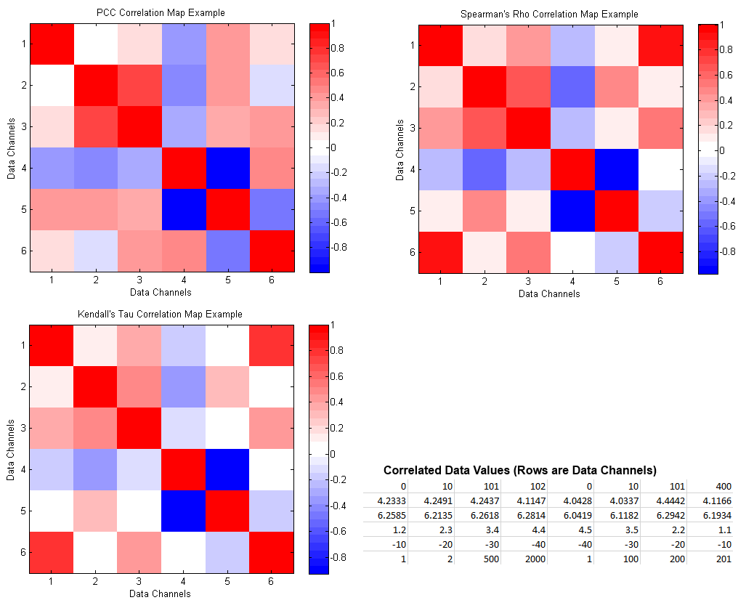
Correlation Metrics: Corrgram Comparison

Slide 20
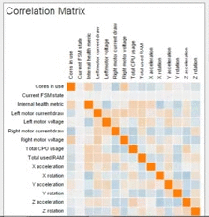

Animated Corrgrams

Slide 21
Overview
Motivation and Objectives
Model Definition
Fault Detection Background
Correlative Analysis and Visualization Background
Lunar Rover Ground Station Development
Intermediate Testing
2D Embedding Visualizations
Future Work and Conclusion
Acknowledgements
References

Slide 22

Hakuto and the Google Lunar XPRIZE

Slide 23
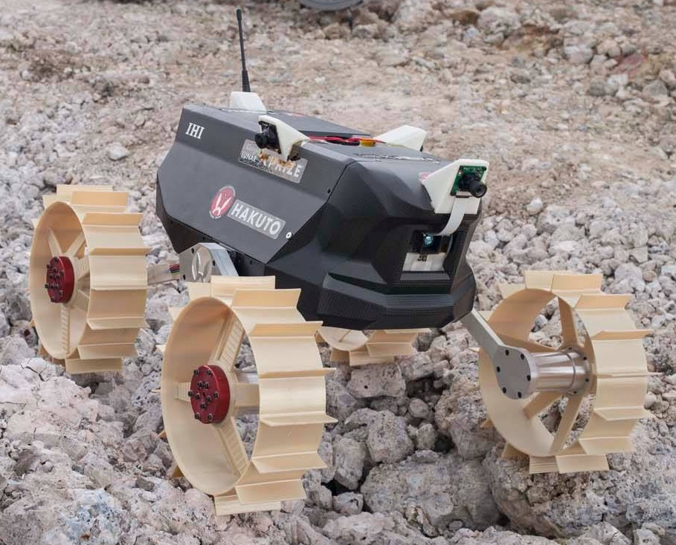
Moonraker Rover

Slide 24
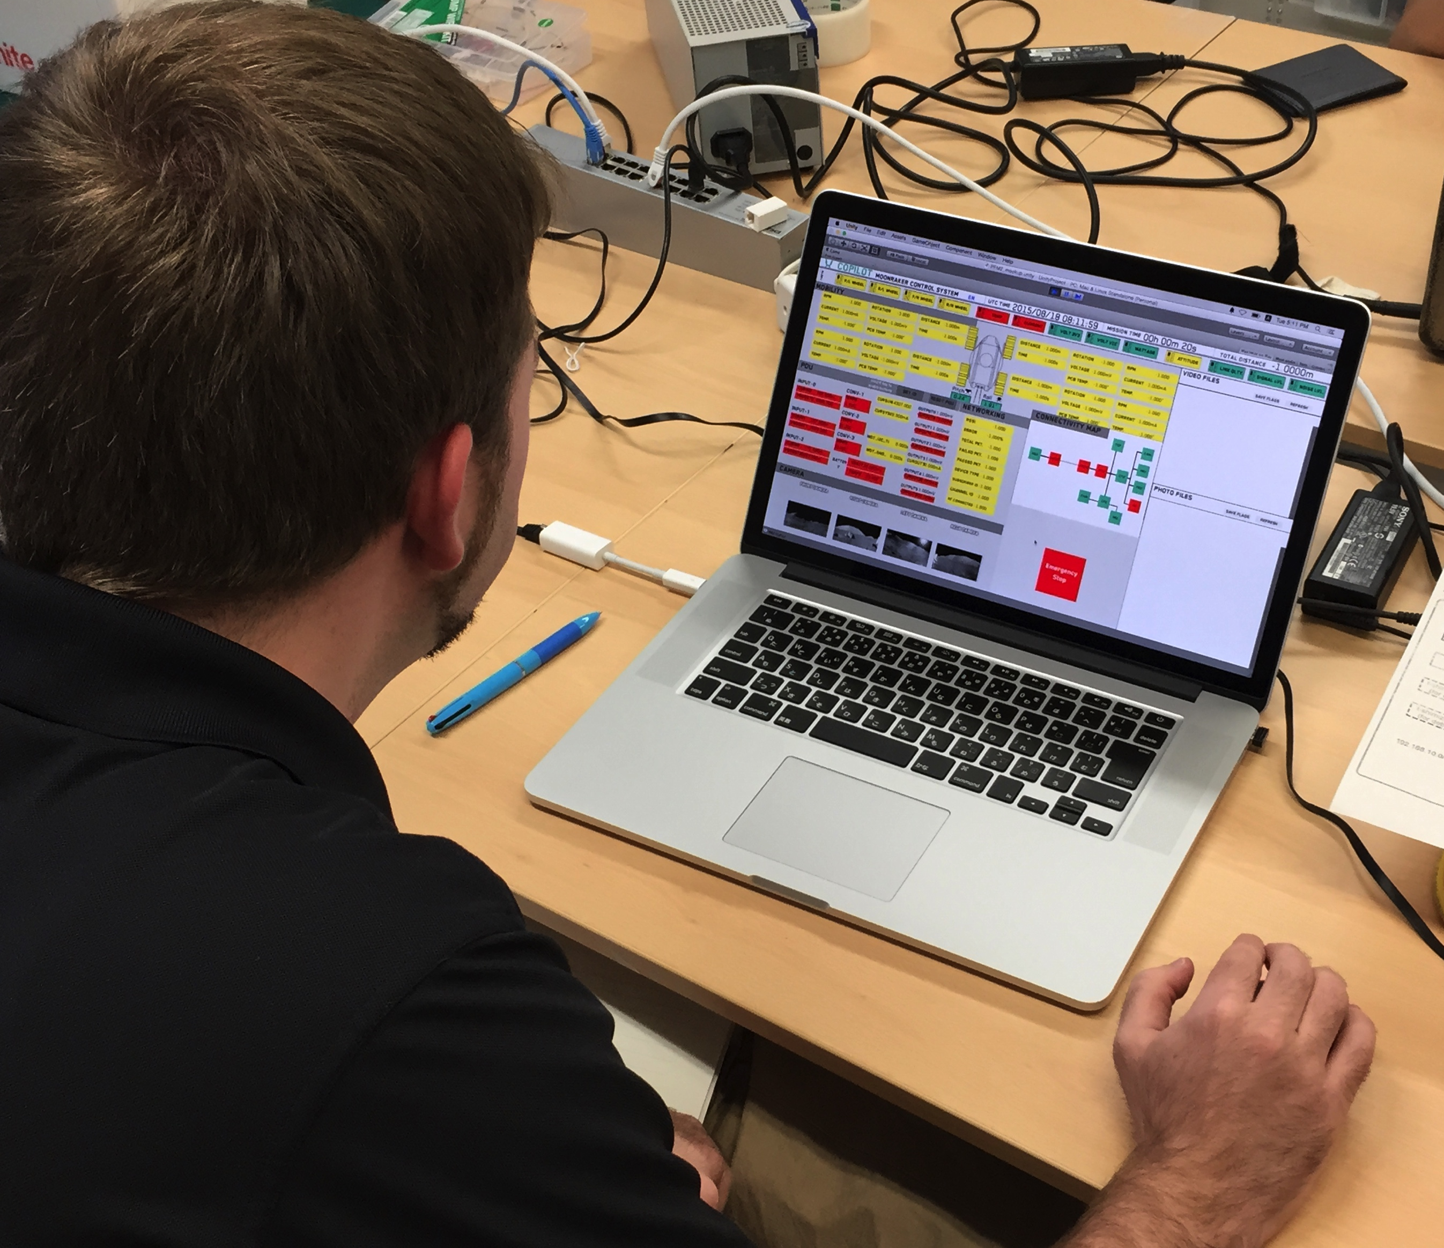
Ground Station Development
Interface for communicating with Moonraker
New system from scratch
Priorities
Easy to understand
Easy commanding
Robust to human error
Maintainable
Unity 3D game engine

Slide 25
Basic Ground Station Features
Numerical telemetry display
Telemetry change indicators
Attitude display
Rover tachometers
Telemetry saving, loading, and playback

Slide 26
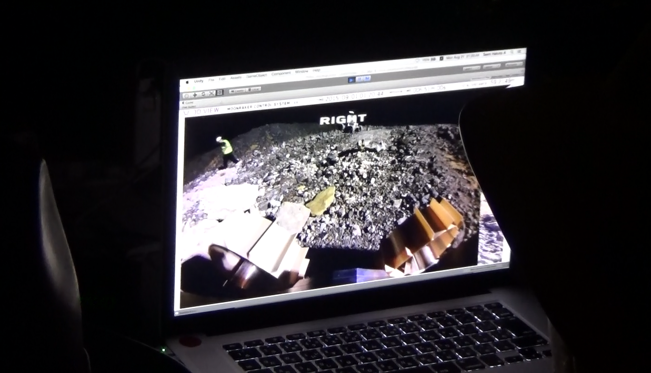
Immersive 3D View

Slide 27
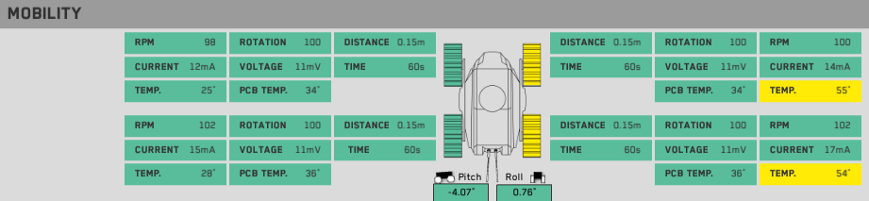
Threshold-Basic Fault Detection

Slide 28
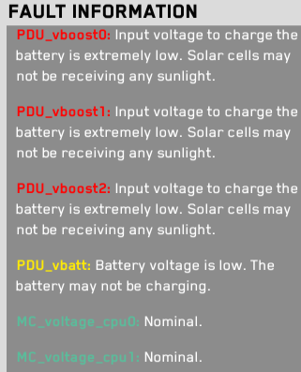
Detailed Fault Information

Slide 29
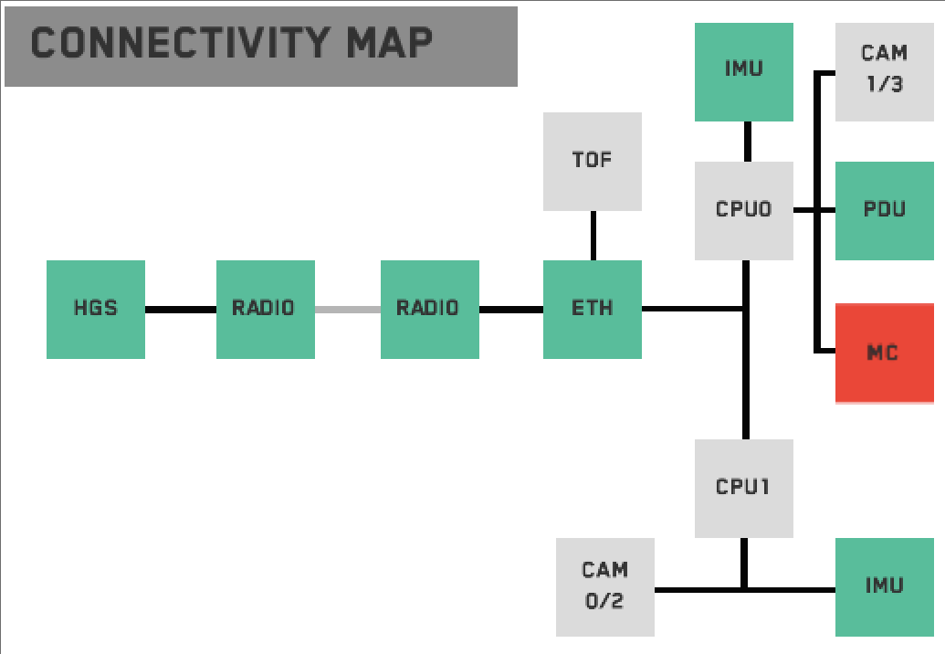
Connectivity Map

Slide 30
FDIR-Related Ground Station Features

Slide 31
Animated Corrgram Implementation

Slide 32
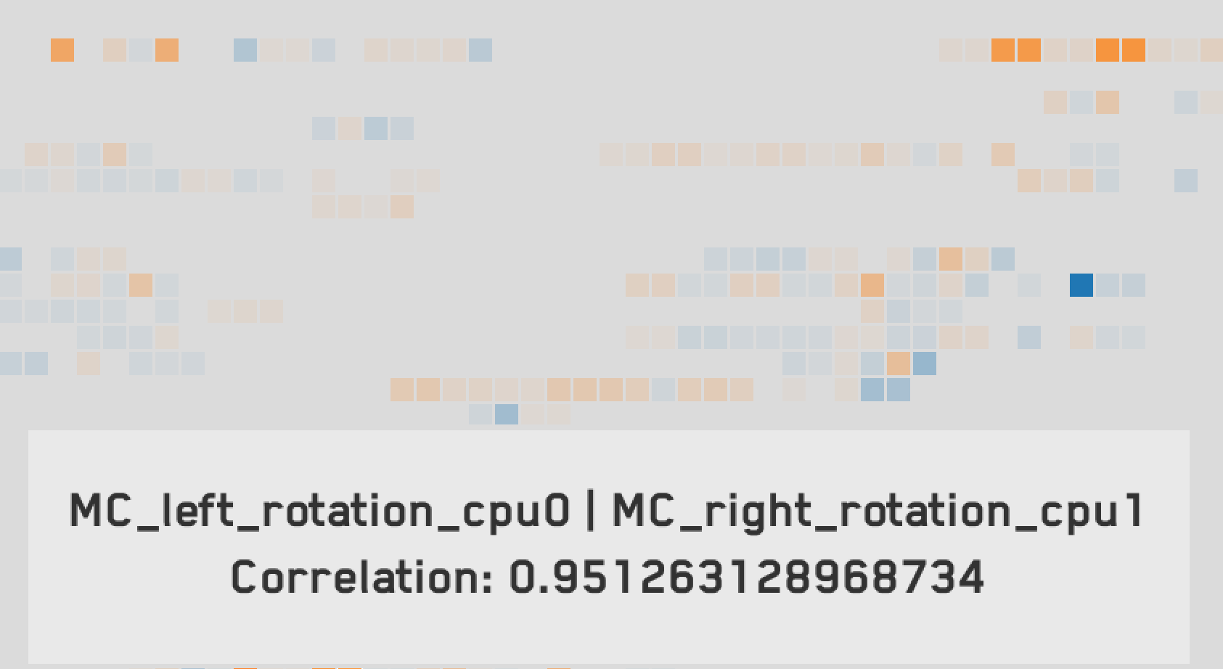
Animated Corrgram Screenshot

Slide 33
Animated Corrgram Details

Slide 34
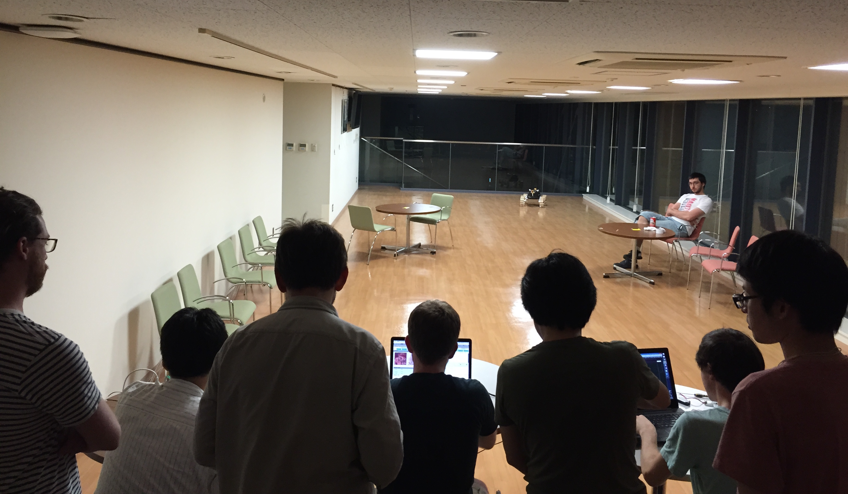
First Integration

Slide 35
Overview
Motivation and Objectives
Model Definition
Fault Detection Background
Correlative Analysis and Visualization Background
Lunar Rover Ground Station Development
Intermediate Testing
2D Embedding Visualizations
Future Work and Conclusion
Acknowledgements
References

Slide 36
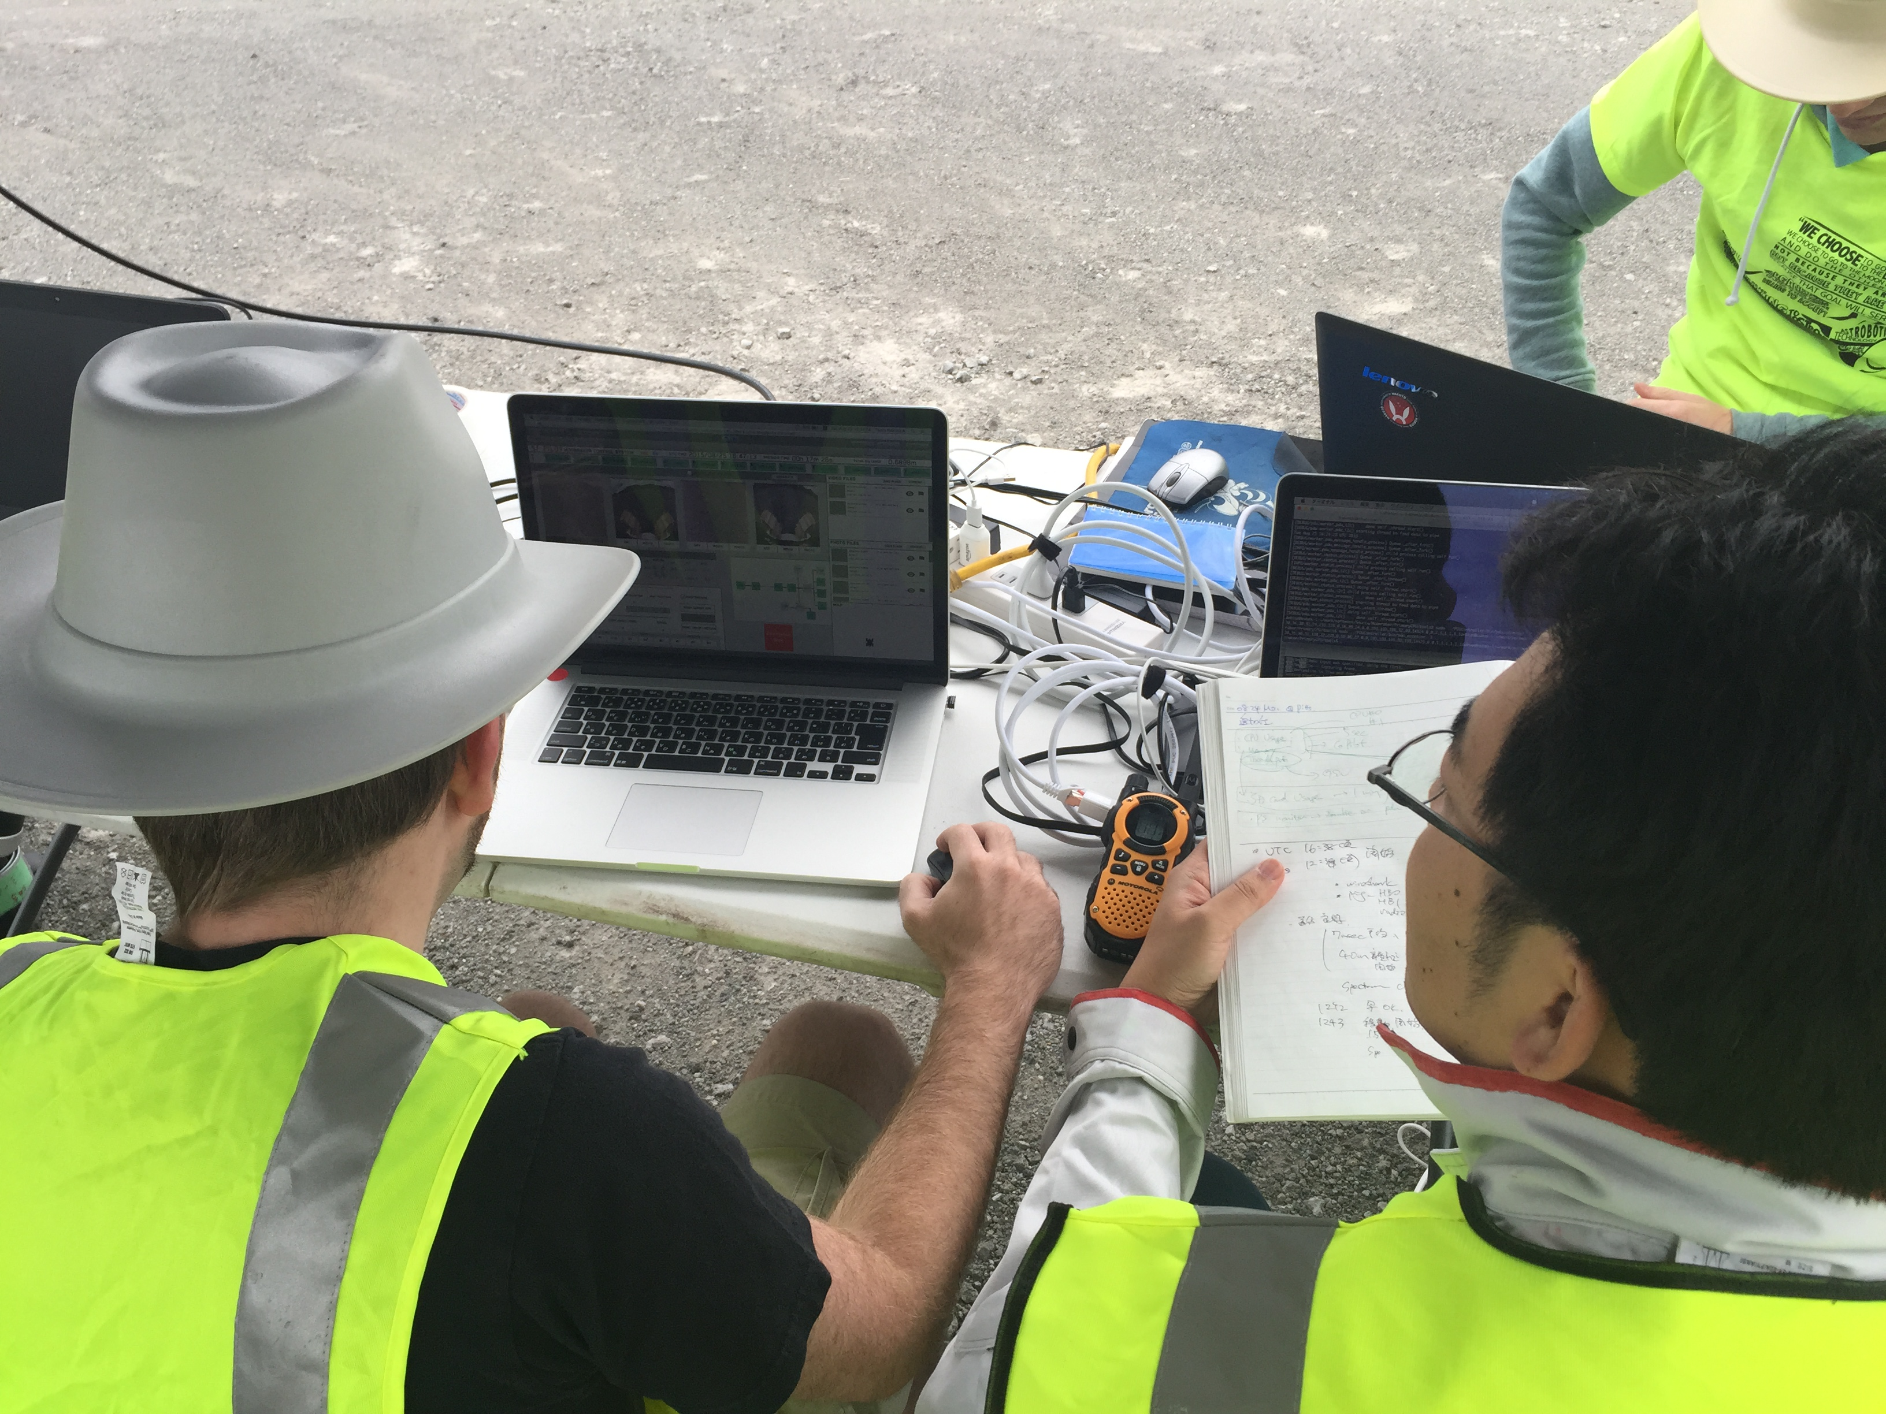
Pittsburgh Field Testing

Slide 37
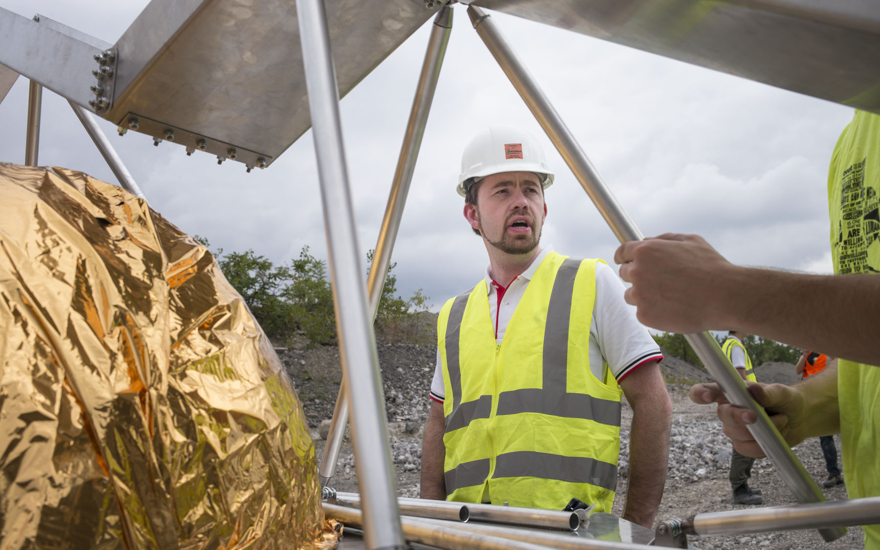
Pittsburgh Field Testing

Slide 38
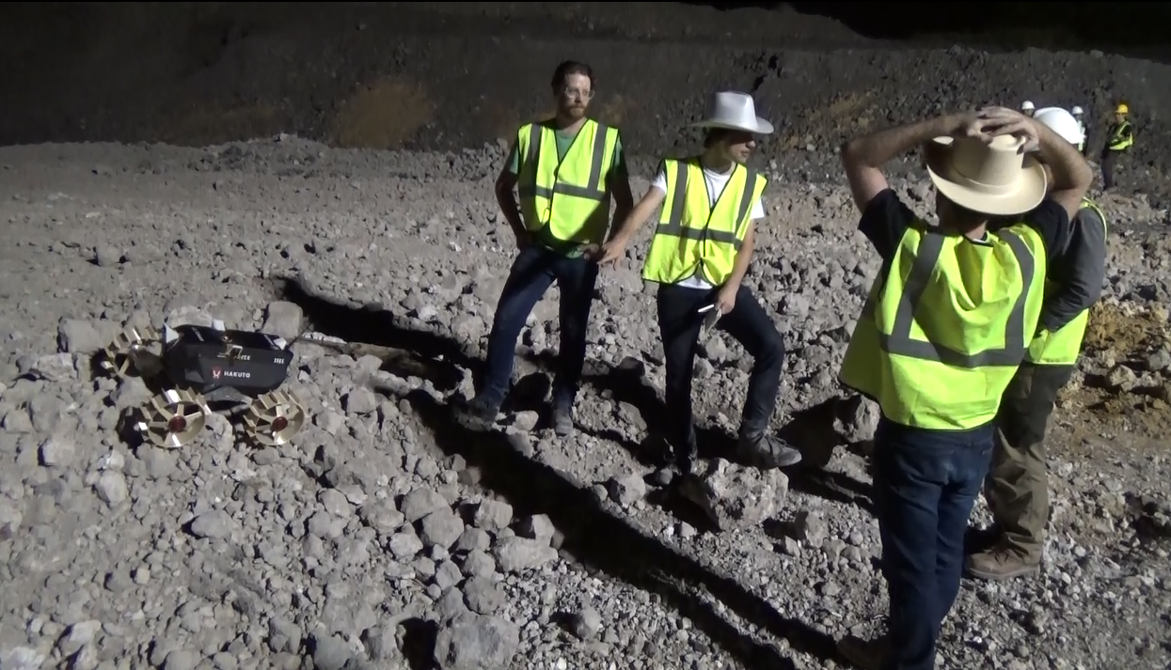
Pittsburgh Field Testing Results

Slide 39
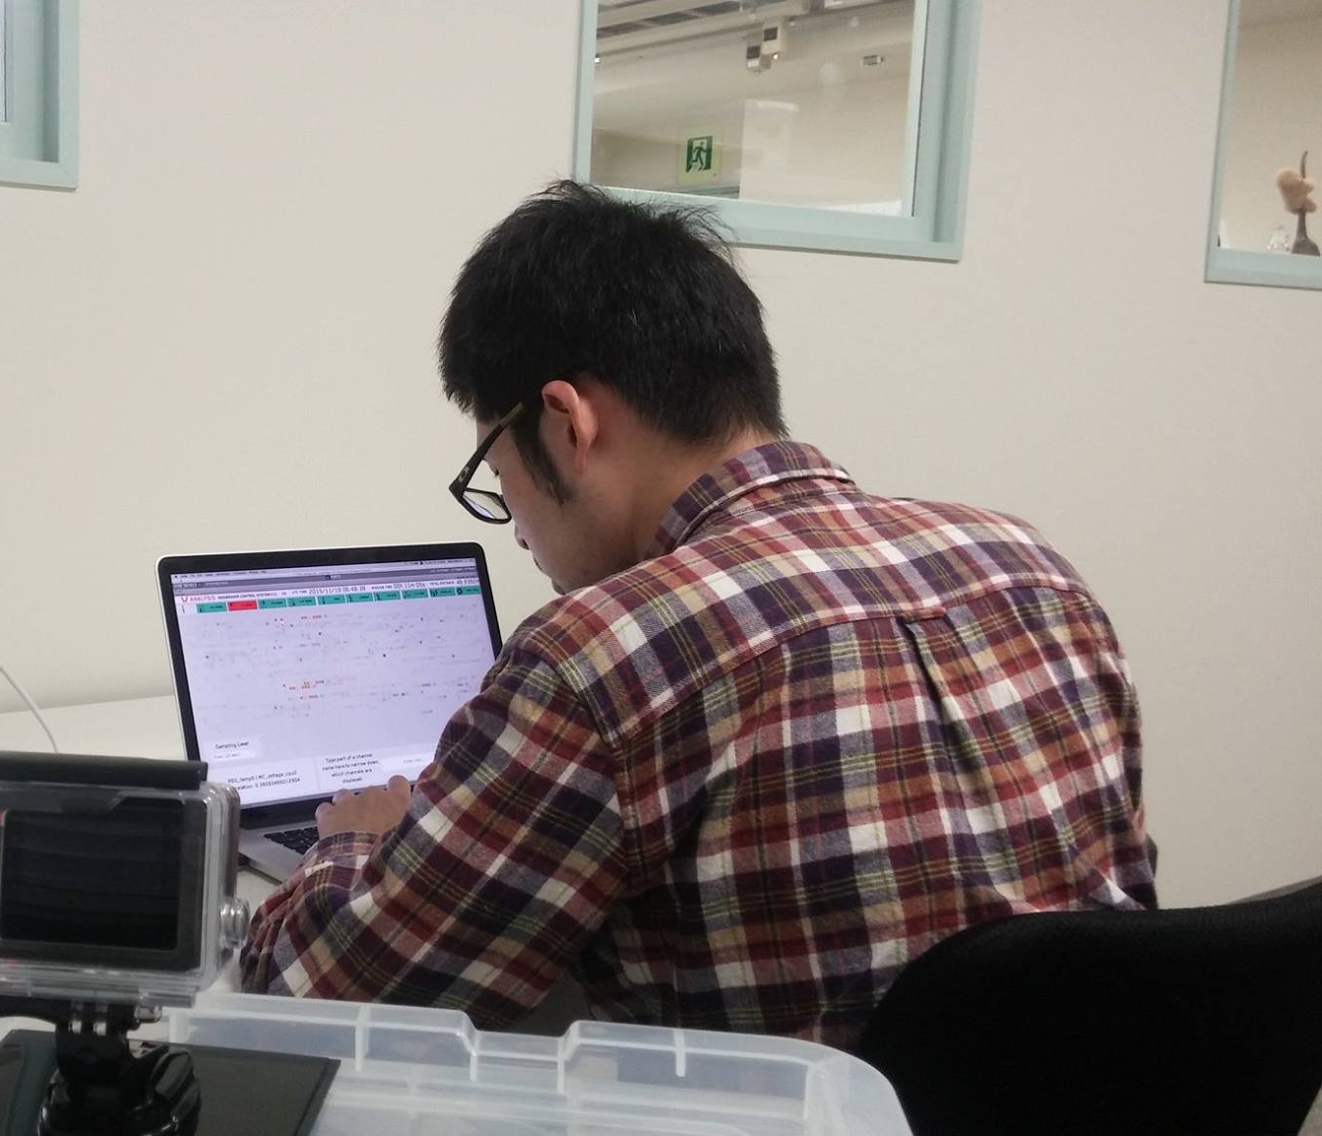
Usability Testing Overview

Slide 40
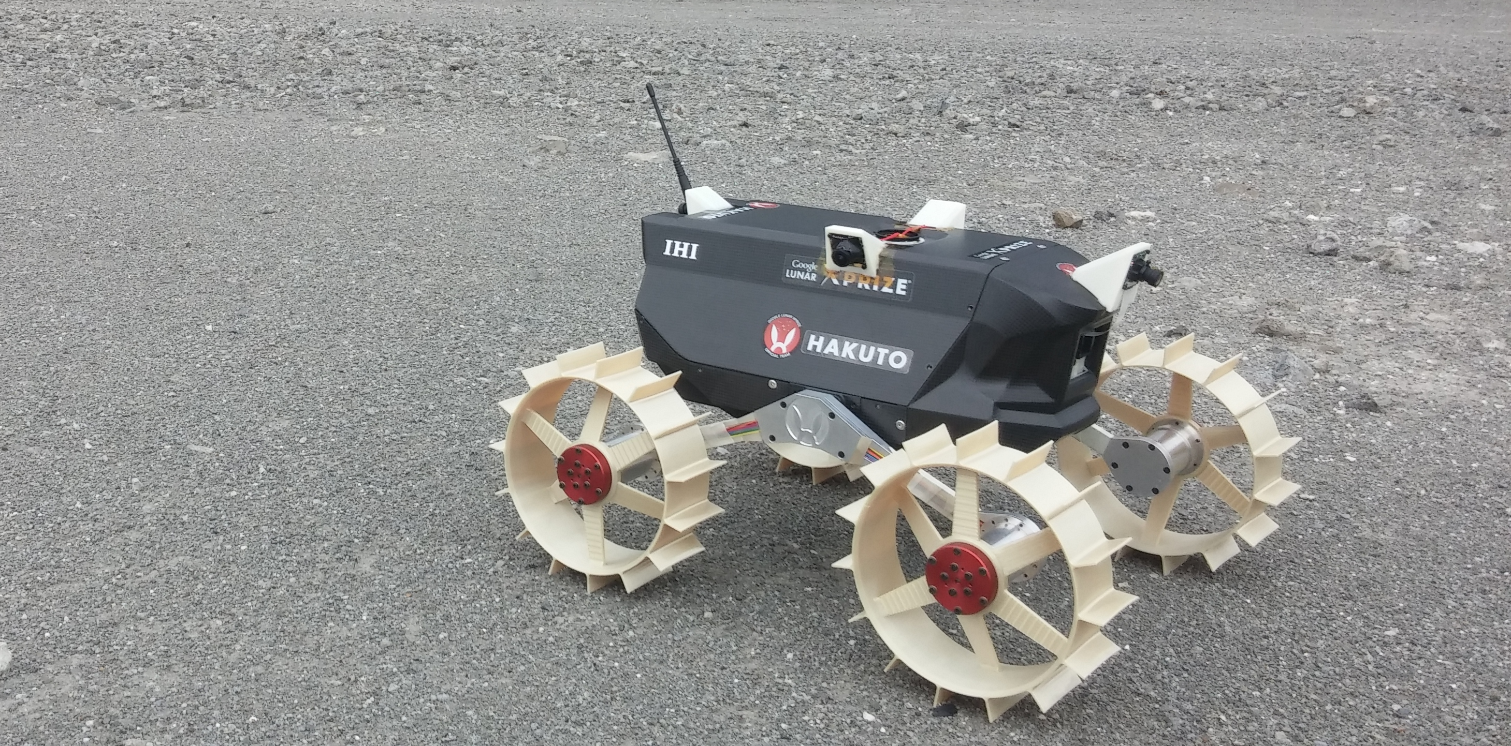
Usability Testing Events
0s Rover begins traveling forward along smooth terrain.
188s Rover enters crater; begins descending into crater.
223s Rover loses line of sight with lander and packet drops begin.
287s Rover enters shade, causing temp, comms, and power drops.
300s Rover begins traversing smooth bottom of crater.
330s Rover begins climbing out of crater.
343s Rover exits shade; continues uphill.
534s Rover emerges from crater and enters smooth terrain.
594s Rover enters choppy terrain.
643s Rover wheel has fault; rover stops moving.

Slide 41
Usability Testing Results

Slide 42
Testing Takeaways

Slide 43
Overview
Motivation and Objectives
Model Definition
Fault Detection Background
Correlative Analysis and Visualization Background
Lunar Rover Ground Station Development
Intermediate Testing
2D Embedding Visualizations
Future Work and Conclusion
Acknowledgements
References

Slide 44
Full Correlation State

Slide 45
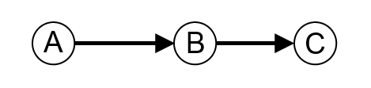
Undirected Correlation Graphs

Slide 46
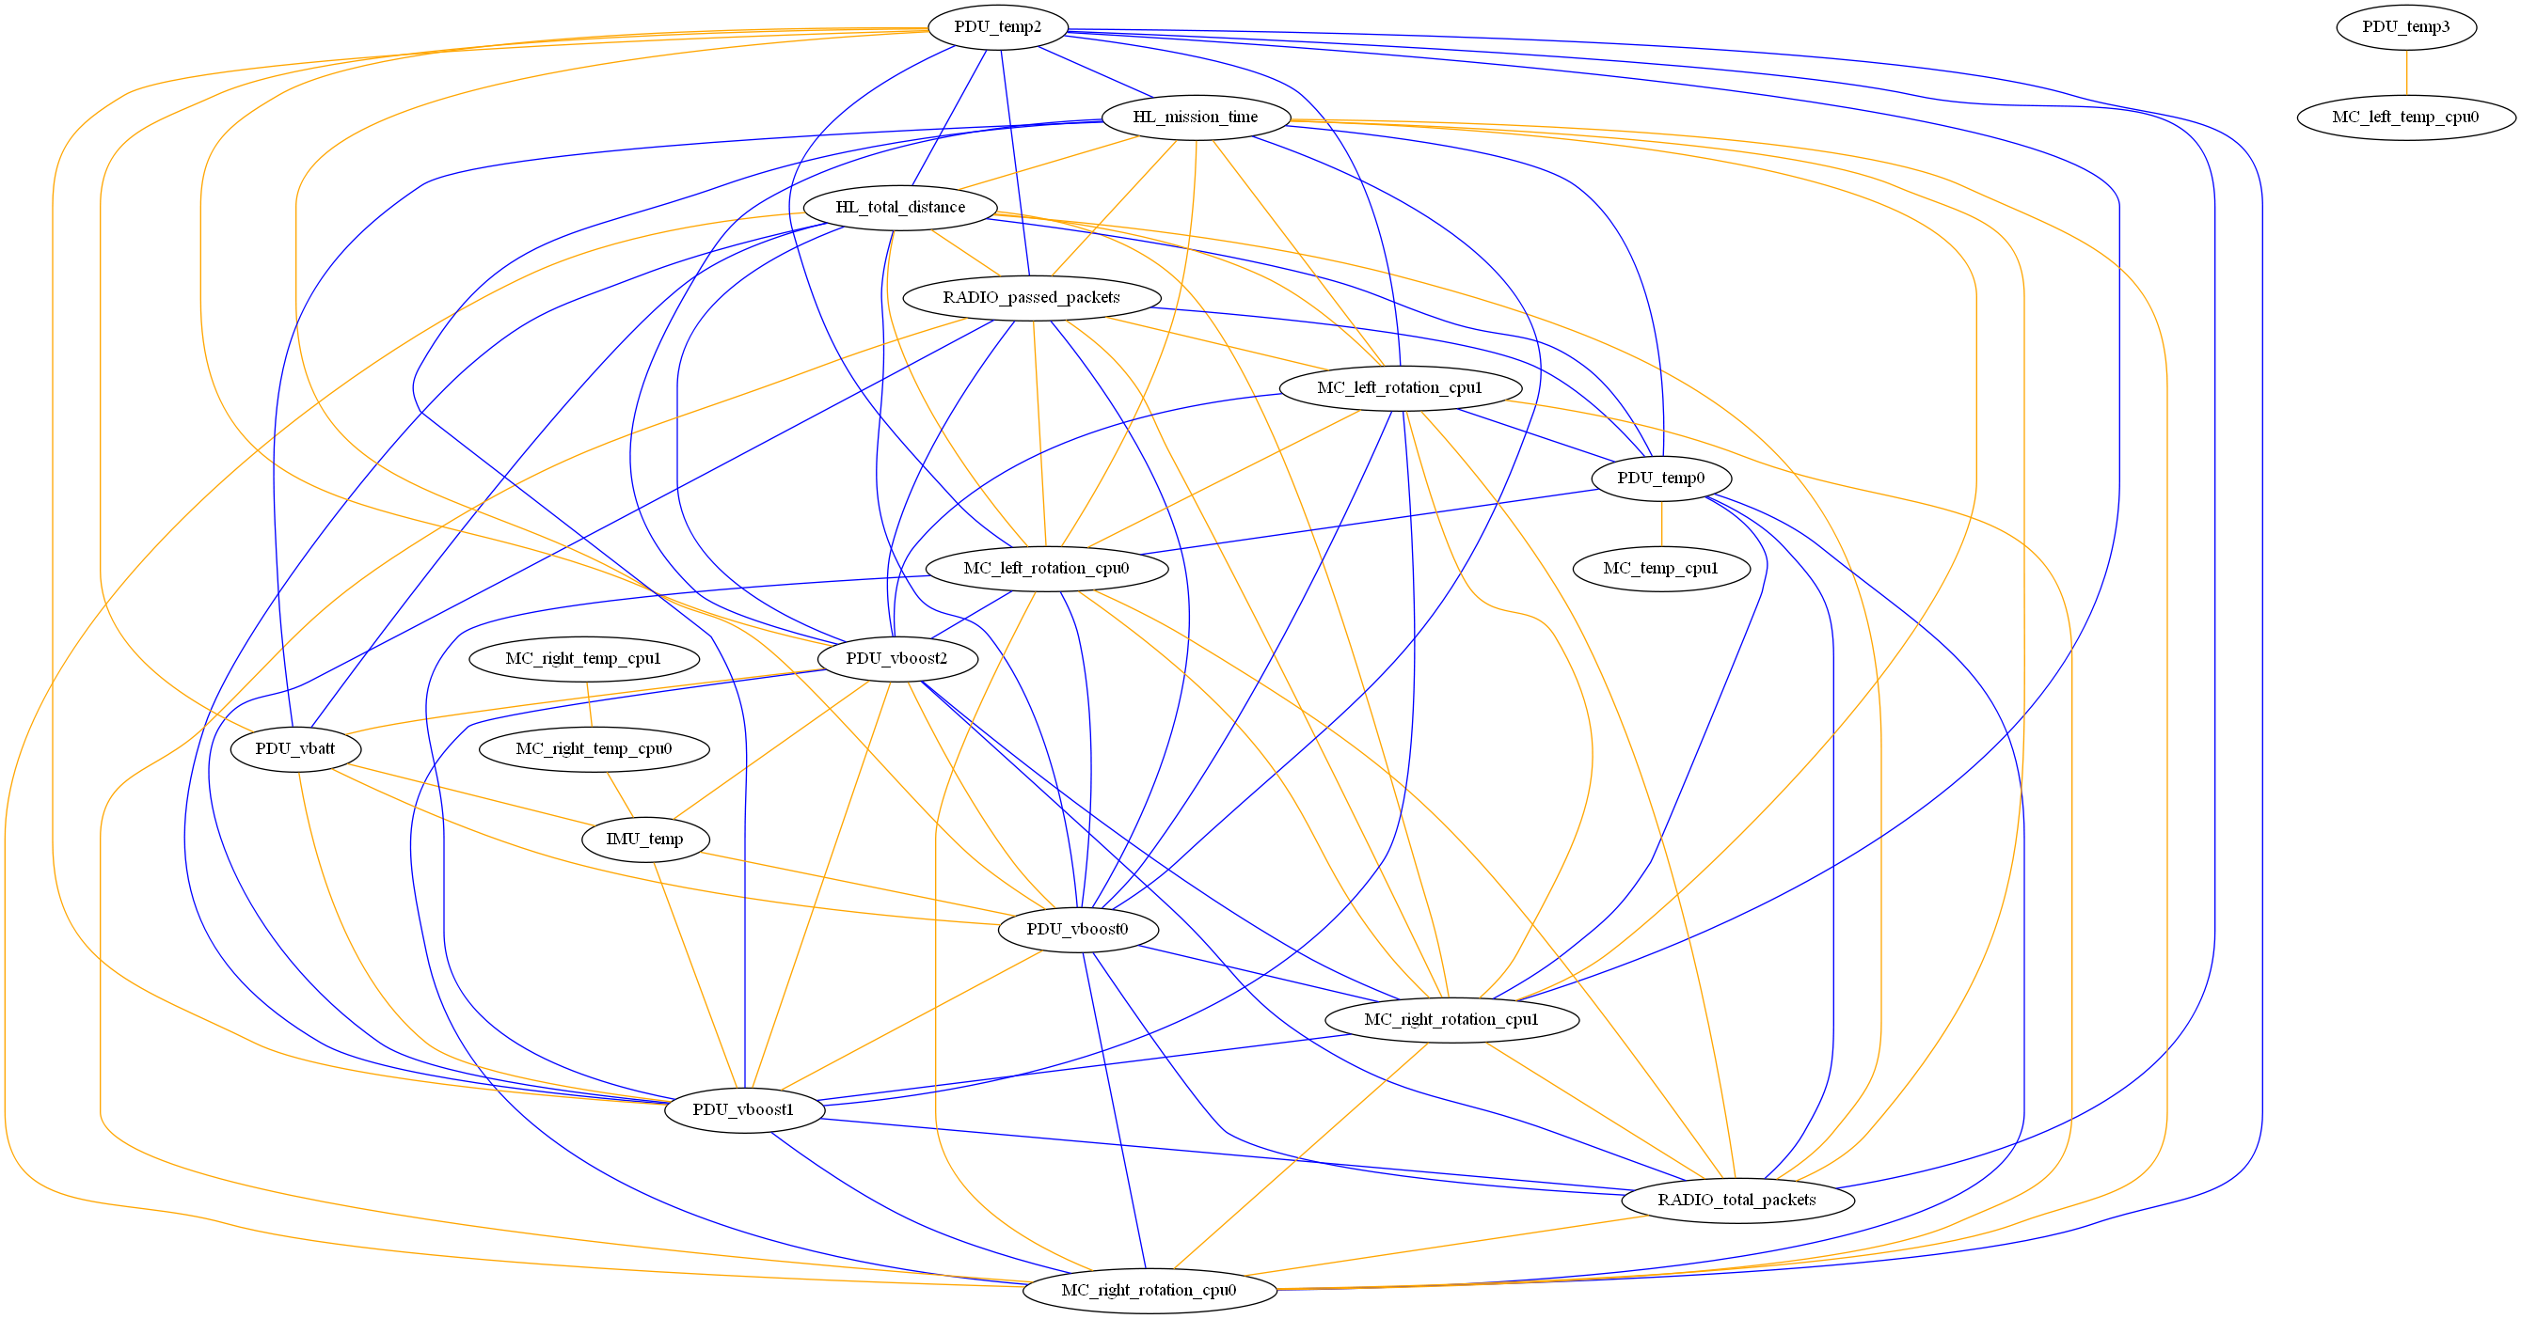
UCGs: Full Correlation

Slide 47
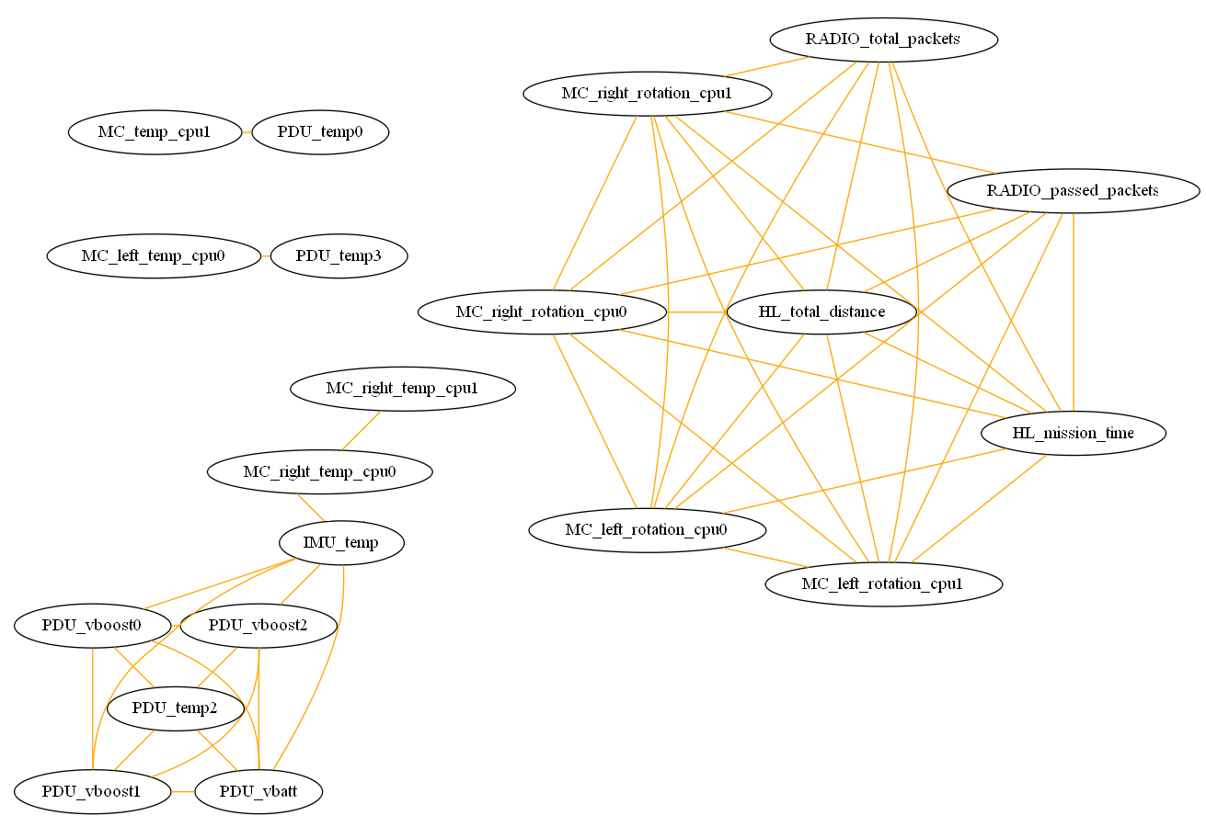
UCGs: Positive Correlations Only

Slide 48
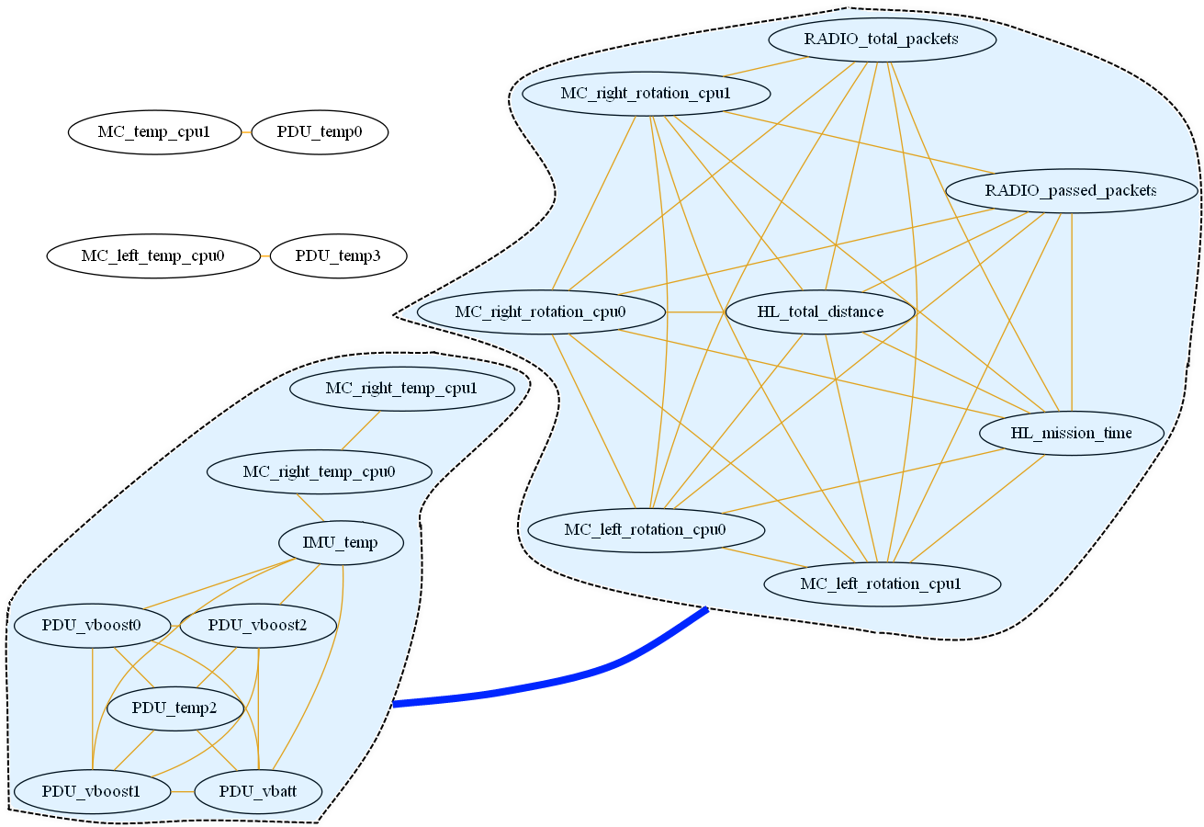
UCGs: Positive Correlations with Cluster Correlations

Slide 49
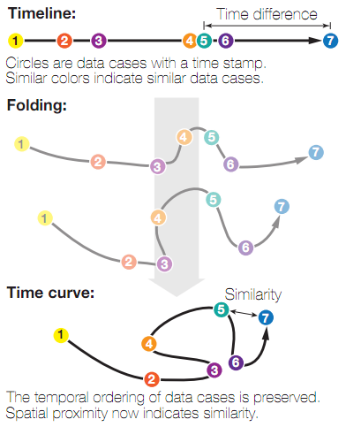
Time Curves

Slide 50
Applying Time Curves

Slide 51
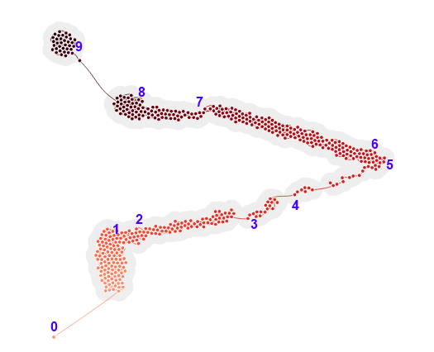
Time Curves on Raw Telemetry State Data

Slide 52
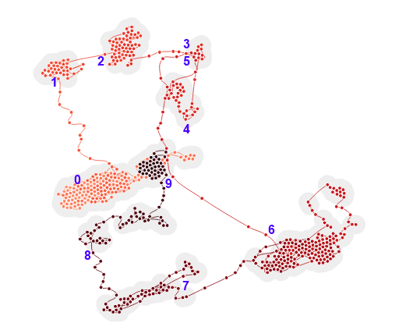
Time Curves on PCC Correlation State

Slide 53
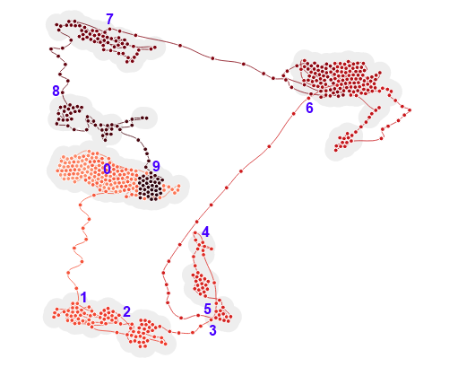
Time Curves on Rho Correlation State

Slide 54
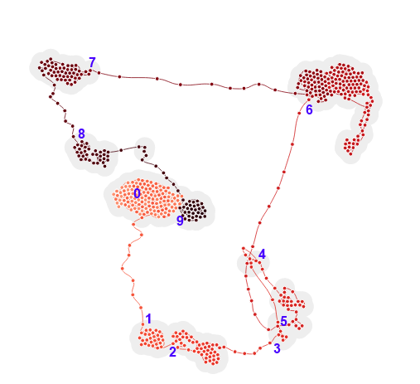
Time Curves on Tau Correlation State

Slide 55
Overview
Motivation and Objectives
Model Definition
Fault Detection Background
Correlative Analysis and Visualization Background
Lunar Rover Ground Station Development
Intermediate Testing
2D Embedding Visualizations
Future Work and Conclusion
Acknowledgements
References

Slide 56
Further Work

Slide 57
Conclusion

Slide 58
Overview
Motivation and Objectives
Model Definition
Fault Detection Background
Correlative Analysis and Visualization Background
Lunar Rover Ground Station Development
Intermediate Testing
2D Embedding Visualizations
Future Work and Conclusion
Acknowledgements
References

Slide 59
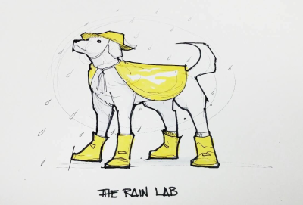







Acknowledgements

Slide 60
Overview
Motivation and Objectives
Model Definition
Fault Detection Background
Correlative Analysis and Visualization Background
Lunar Rover Ground Station Development
Intermediate Testing
2D Embedding Visualizations
Future Work and Conclusion
Acknowledgements
References

Slide 61
References

Slide 62
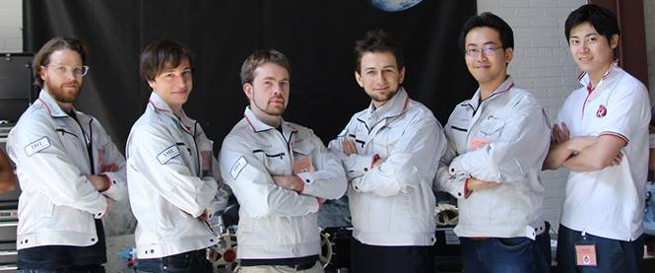
Thank you!
Questions?

